Slide 1
Artificial Labs technical task
Valery (Galina) Gasparyan

Slide 2
General Data Statistics
The dataset contains 1000 rows and 5 columns:
Country, description, points, price, variety
There are no missing values
Summary Statistics for points and price
count | 1000 | 1000
mean | 87.81 | 33.36
std | 3.37 | 28.63
min | 80 | 6.00
25% | 85 | 18.00
50% | 88 | 25.00
75% | 90 | 40.00
max | 98 | 463.00

Slide 3
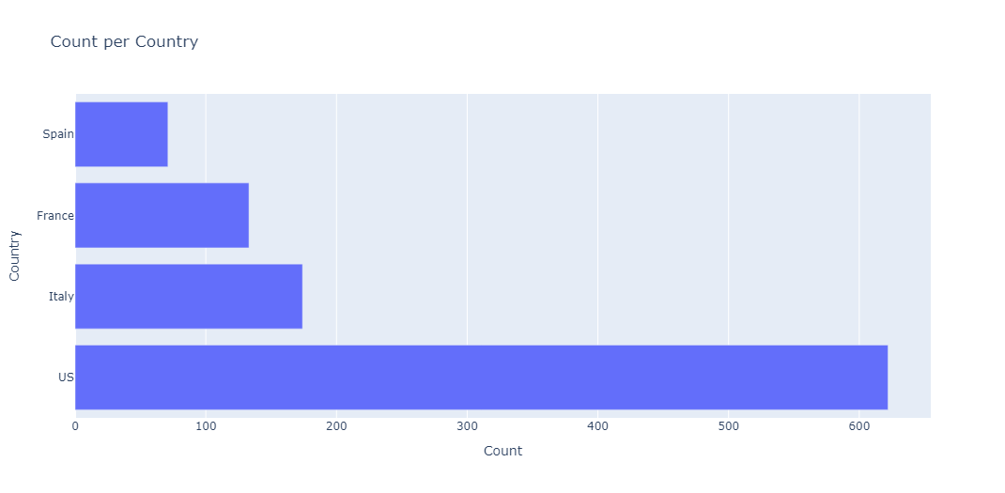
Countries distribution
Objective: To explore the distribution of countries in the dataset and identify any bias.
Findings:
It is visible from the bar chart that US wines are much more prevalent in the dataset in comparison to Spain/France/Italy.
As a result the dataset would require oversampling (SMOTE) to be performed on underrepresented countries during the training process of the model

Slide 4
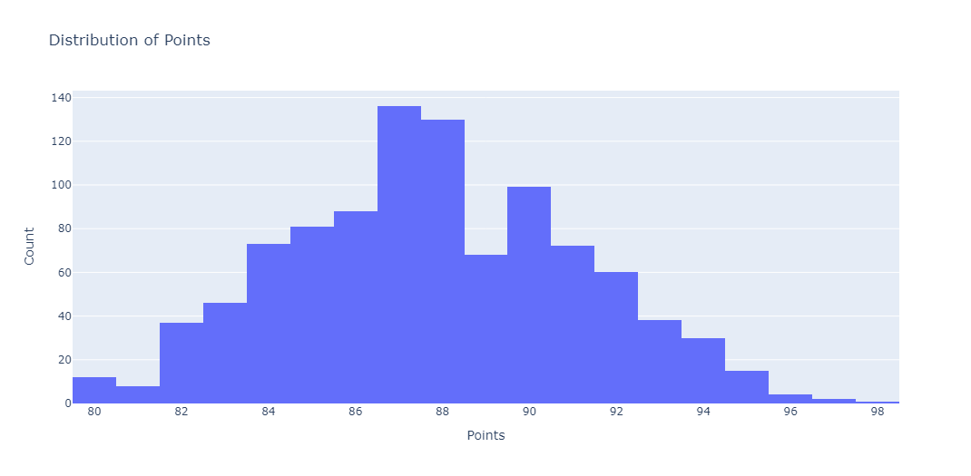
points distribution
Objective: To explore the distribution of points and identify potential transformations.
Findings:
Data for points seems normally distributed
Data points start at 80 and therefore would require normalisation for future use in the model
You can see normalised distribution in Wine_EDA notebook

Slide 5
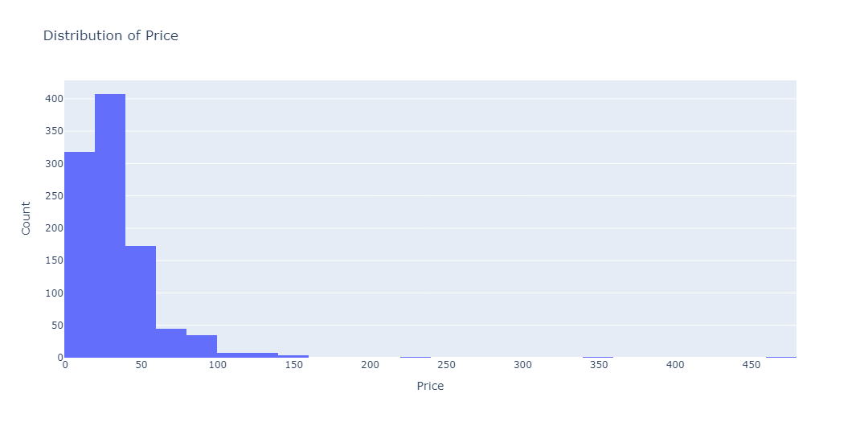
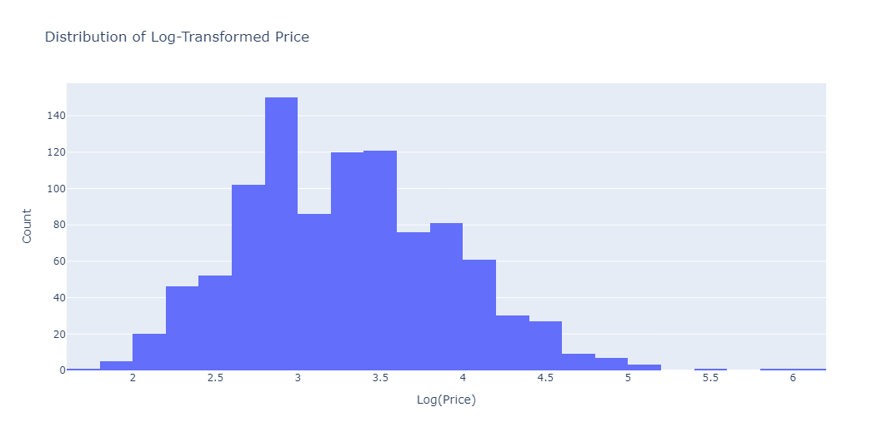
Price distribution
Objective: To explore the distribution of price and identify potential transformations.
Findings:
Data for price is positively skewed, therefore requires log-transformation
After log transformation we get closer to normal distribution, however datapoints are still on a scale up to 6, so we require further normalisation
You can view normalized distribution in the Wine_EDA notebook

Slide 6
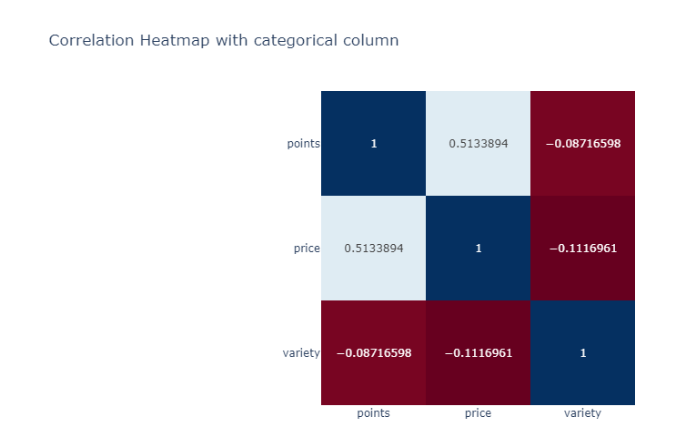
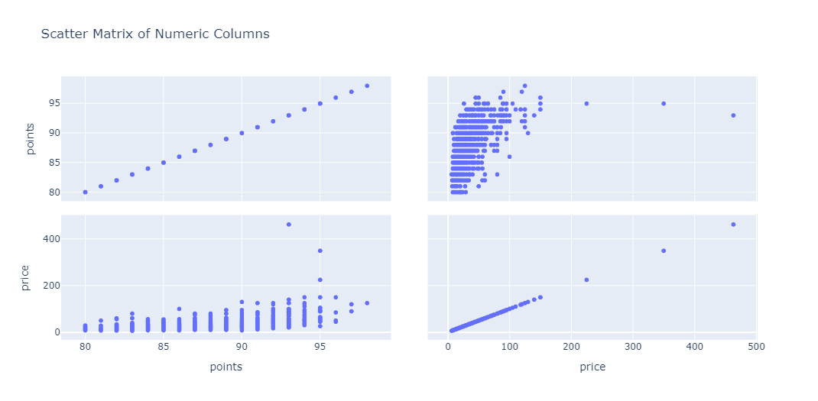
Correlations
Objective: Compare numeric columns for further feature engineering (and heatmap for variety).
Findings:
There is a moderate linear relationship between price and points (0.5)
No relationship found with variety

Slide 7
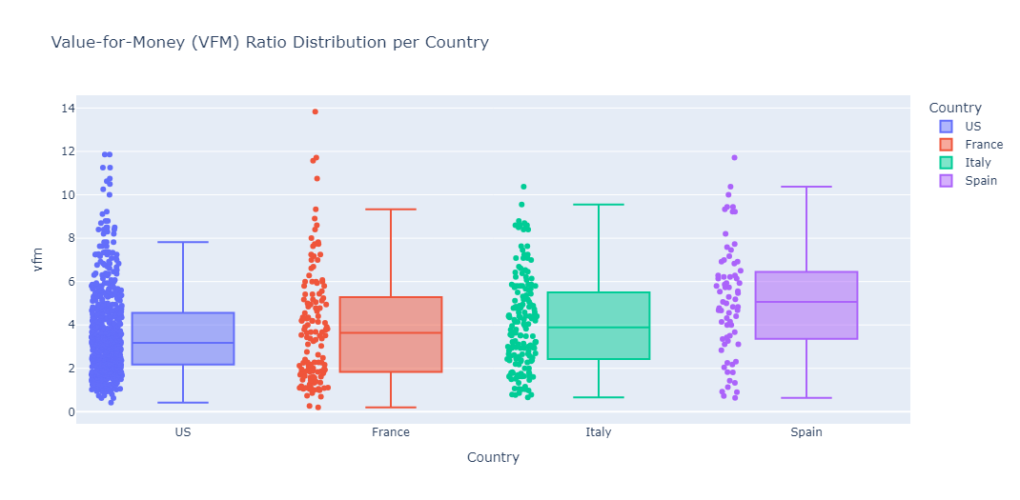
Feature engineering
Objective: Since Price and Points have moderate correlation, we can combine them to produce new features.
Value for Money:
By dividing Points by Price we introduce a new variable “Value for Money”
This ratio can highlight wines that are highly rated but inexpensive
Findings:
Countries have different profiles
Spain has the best VFM since its median is the highest among all countries (i.e. Spanish wines provide generally higher quality for a lower price)
US wines tend to be pricier relative to their quality
You can view further findings in the Wine_EDA notebook

Slide 8
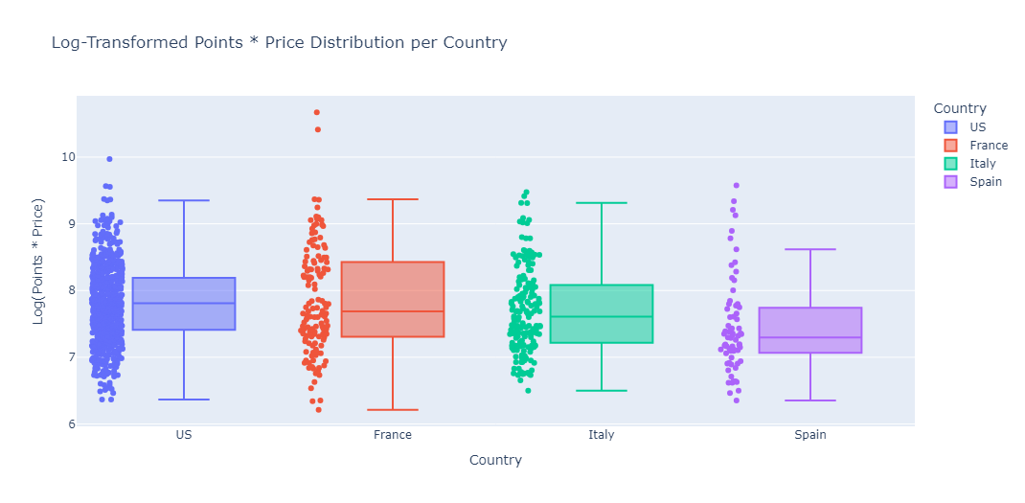
Feature engineering
Points x Price:
We can check the multiplication of these features
This will identify high price wines with high points vs cheap wines with small points
Findings:
Spain shows the best value
It’s narrow and suggests less variability in pricing, indicating focus on affordability of the wine
The log transformed version was used and later normalized
Variety:
Variety was encoded and normalised

Slide 9
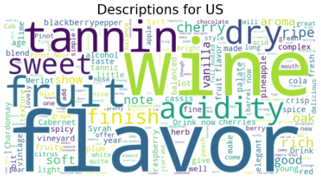
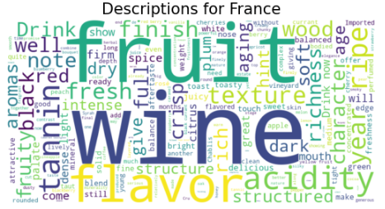
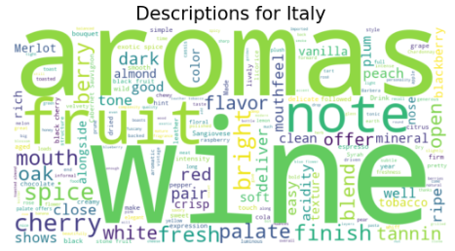
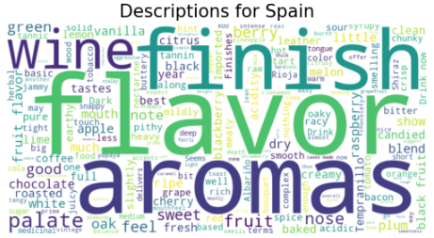
Word clouds

Slide 10
Word clouds
General words describing wines from each country:
US:
Fruit, cherry, tannins, dry, acidity, oak, sweet
US wines have a broader profile with mentions of oak and dry. This can come due to the prevalence of US wines within the data, which gives a wider spread of comments
France:
Acidity, fruit, tannings, ripe, texture
What distinguishes French wines is its bitterness that evidently comes from tannings, acidity and ripeness
Italy:
Fruit, aromas, cherry, spice, bright, fresh
In comparison to Spanish wines, Italian wines are more spicy and fresh. Their palate also concentrates around cherry notes
Spain:
Aromas, fruit, nose, berry, sweet, good
Spanish wine descriptions emphasise flavor complexity and aroma. words like sweet and berry give a closer description of the flavor palate

Slide 11
NLP Features
NER locations extractions:
Some descriptions use location entities that can help with model classification
Those locations were extracted using spacy library and then encoded and normalized for use in the model
TF-IDF vectorization:
Captures the importance of words by calculating their frequency
First text is pre-processed and stop words removed
Example features: acidity, aromas, black, cherry, dry etc
POS tagging:
From the description field we can also extract subtle language patterns. One of them are grammatical structures
In our case adjectives were extracted to describe the wine style, embeddings were applied later
Sentiment Analysis:
Positive statement may be related to some highly rated wines
Emotional tone was captured by polarity (emotional sentiment) and subjectivity
Word Embeddings:
I decided to also perform general word embeddings on the description
Later on 2 models were trained – one with adjectives and another with general embeddings

Slide 12
LLM powered NLP Features
Traditional methods (NLP) treat words independently and ignore context, while LLMs capture contextual relationships.
Leveraging LLMs is useful in terms of efficiency, since they are pre-trained on massive datasets.
It can optimise our features since it can handle several tasks at once - such as text classification, NER and semantic similarity all within one framework.
The models were taking time-out errors, those were taken care of
Semantic Features:
Gpt-4o-mini model was used to generate key attributes for wine from descriptions
They were later transformed into binary features (has_cherry, has_oak), or categorical features (tanin_level)
NER for locations:
This feature is meant to replace the original NER conducted in the NLP only features
In comparison to NLP feature, LLM has extracted more non-empty rows
LLM summarization with TF-IDF:
LLM can provide us with summaries of descriptions
Those were later encoded and embedded using TF-IDF

Slide 13
Modelling
The following 5 models were implemented:
Basic EDA features only (no NLP or LLM powered NLP features)
Adjectives embeddings NLP features model
Word description embeddings NLP features model
LLM powered NLP features model
Auto-embedding model on adjectives NLP features (to substitute Word2Vec embeddings with Tensorflow layer embeddings)
You can view the results, evaluation and top 10 features for the models in the Wine_ML_models notebook

Slide 14
Models descriptions
Main model:
This model is a deep feedforward neural network designed for multi-class classification of wine origins.
It consists of three dense layers (256 → 128 → 64 neurons) with ReLU activation, batch normalization for stability, and dropout (0.4 → 0.3 → 0.2) to prevent overfitting.
The output layer uses softmax activation to predict one of four countries.
The model is optimized using Adam (learning rate = 0.001) for adaptive learning and trained with sparse categorical crossentropy, which is well-suited for integer-encoded labels.
Early stopping monitors validation loss, preventing unnecessary training if performance stops improving.

Slide 15
Models descriptions
Auto-encoding model:
This multi-input neural network combines text-based and numerical features to classify wine origins.
The text input (adjectives) is processed through a TextVectorization layer, then embedded into a 128-dimensional space, and passed through a GRU layer (128 units) to capture sequential patterns.
The numerical input (23 features) is processed using a dense layer (64 neurons, ReLU activation) with dropout (0.3) to prevent overfitting.
The two feature types are then concatenated and passed through a fully connected layer (64 neurons, ReLU, dropout 0.3) before reaching the final softmax output layer for classification into one of four categories.
The model is optimized using Adam (learning rate = 0.001) with sparse categorical crossentropy for multi-class classification.
Early stopping monitors validation loss to prevent overfitting.
This hybrid architecture effectively leverages both structured numerical data and unstructured text

Slide 16
Thanks
Thanks for allowing me to partake in this technical task, it was an interesting challenge. I tried to approach it as I would at my current workplace, however I understand that Artificial Labs may have a different approach. I am more than willing to develop these skills within Artificial Labs.

